Slide 1

Introduction to Arduino

Slide 2


Slide 3
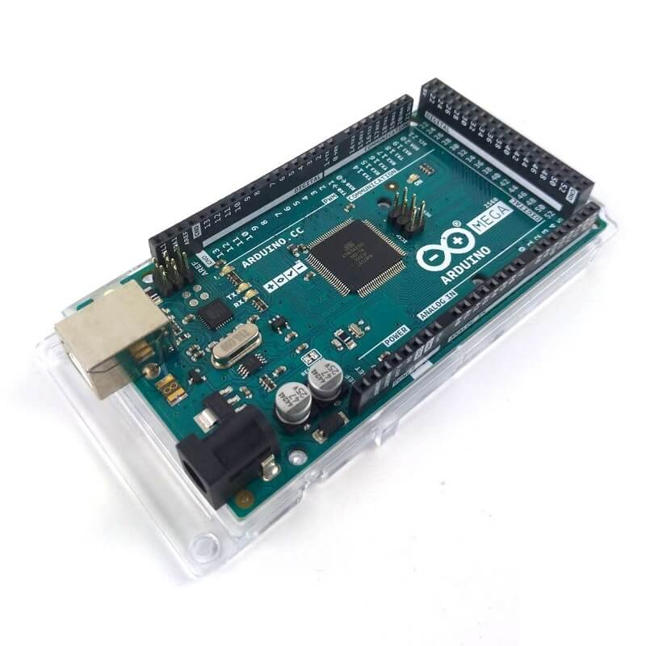
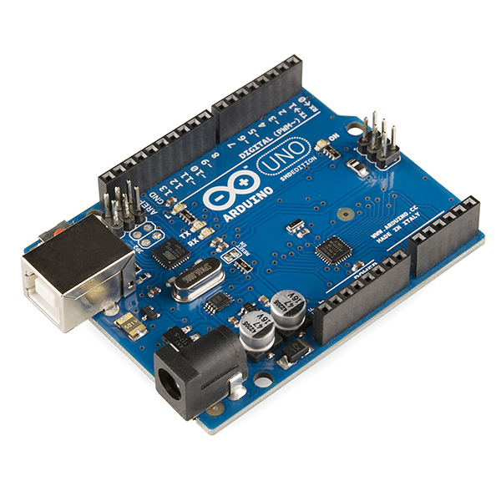
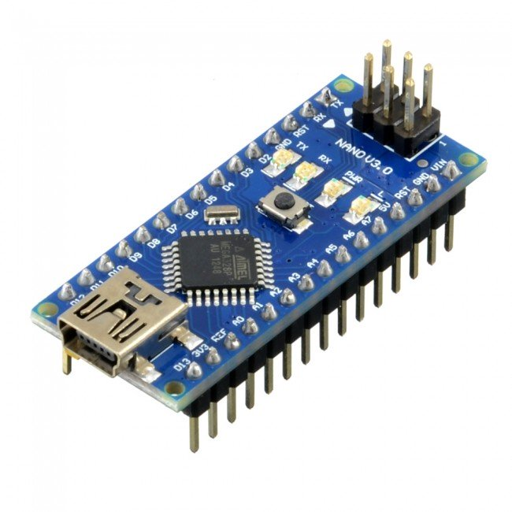

Slide 4
Open Source
Built for wide variety of users
Prototyping
Hobbyists
Founded in the Interaction Design Institute Design (IDII) in Ivrea, Italy

Slide 5
Maker Uno

Slide 6
VS

Slide 8
Analog vs Digital
Analog: any value between 0V – 5V
Digital: Only 0V(Logic Low/ ‘0’) or 5V(Logic High/ ‘1’)

Slide 9
Basic Command
pinMode(pin, mode)
Mode: INPUT, INPUT_PULLUP, OUTPUT
digitalWrite(pin, value)
Value: HIGH, LOW
delay(ms)

Slide 10
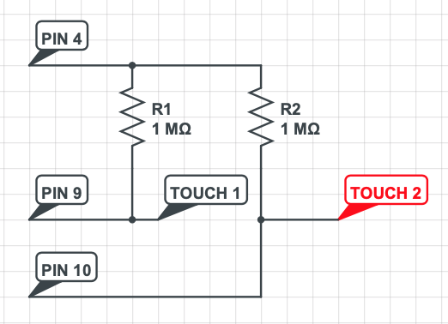
Circuit diagram for Mini Piano

